Slide 1
An Unsupervised Misinformation Detection Framework to Analyze the Users using COVID-19 Twitter Data
17102042 김민선

Slide 2
INTRODUCTION
METHODOLOGY
RESULTS AND DISCUSSION
LITERATURE REVIEW
CONCLUSION

Slide 3
INTRODUCTION
After the spread of Covid-19, social media has become most frequently use source of sharing the news and information
However, misinformation disseminates in social media Literature
Earlier works relying on manual or annotation-based approaches posed limitations: 1) time and labor-intensive, 2) requires domain knowledge to identify the context of the news

Slide 4
INTRODUCTION
Fake news tends to spread significantly faster, farther, deeper and more broadly than truth (high likelihood of retweeting false information by common public, not bots)
This research propose an unsupervised framework for detecting misinformed content and the users who may be the source or susceptible to sharing misinformation.
The proposed framework leverages popularity of the tweets and the credibility of their sources (users) to identify the misinformed users and contents.

Slide 5
PROPOSED FRAMEWORK
1. Identification of popular/influential tweets and then credibility of them
- a set of semantically similar critical clusters generated
2. Backtrack the tweet-retweet connection to identify the original-poster of tweets for each cluster
- Veracity of a cluster is measured in terms of the proportion of the credible users (news sources, medical organizations, medical influencers, verified accounts)
- Accuracy validation, Performance validation

Slide 6
LITERATURE REVIEW
Text-based/message-centric models highly require enough labeled data to identify the fake news writers’ textual features
User-centric approaches is developed
Vosoughi et al. revealed that humans were much more likely to spread the misinformation not bot.
They also suggested that false news disffuse farther, more in-depth, faster and deeply ->
Hybrid approaches appears that use text and the user-level information to identify the misinformed content
Popularity of the tweets and retweets are also used in this model

Slide 7
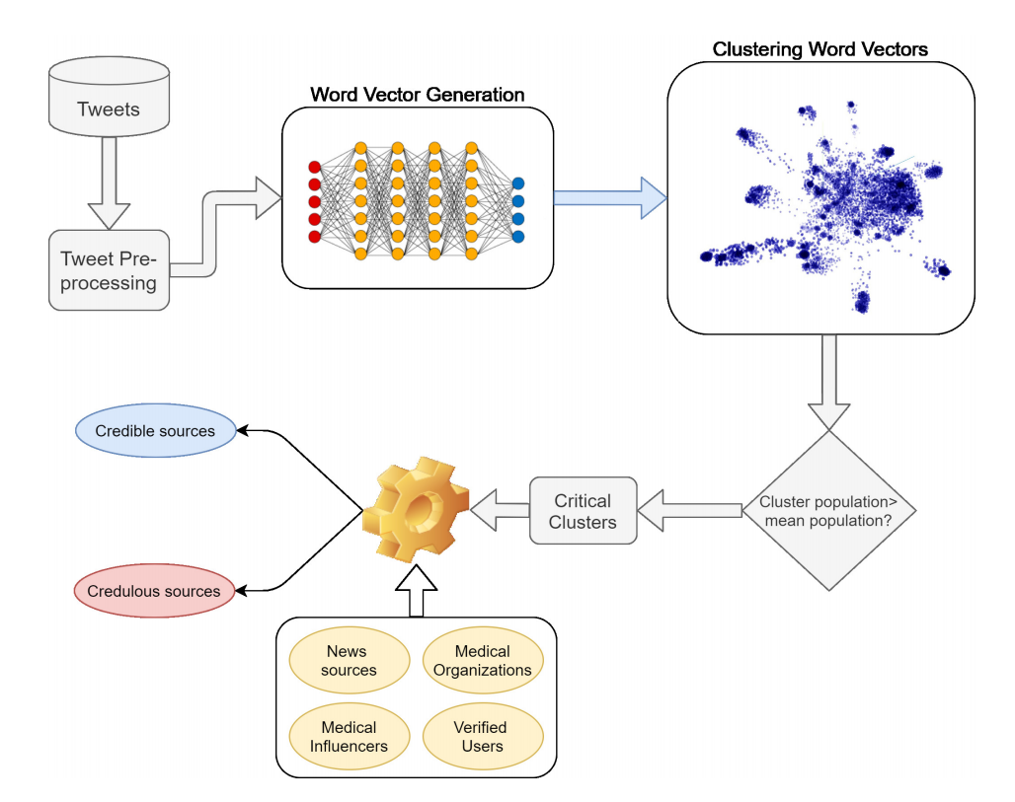
PROPOSED FRAMEWORK
Textual Feature
Popularity of tweets
Four credible user-categories

Slide 8
METHODOLOGY
Data collection and Preprocessing
Twitter Streaming API
Extract only essential features
Remove impurities of text data

Slide 9
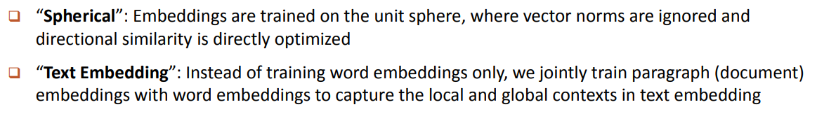
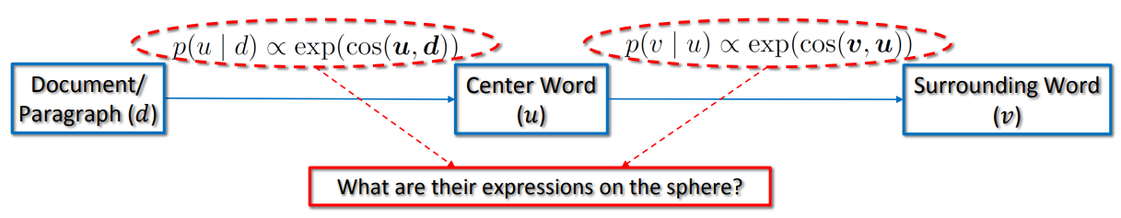
METHODOLOGY
2. Identifying Critical Clusters
First, the semantically similar tweets are grouped to form clusters
JoSe, a spherical text embedding generation deep learing model
High performance in clustering vector representations with less run-time requirement (not only local context but also global context co-occurrence)

Slide 10
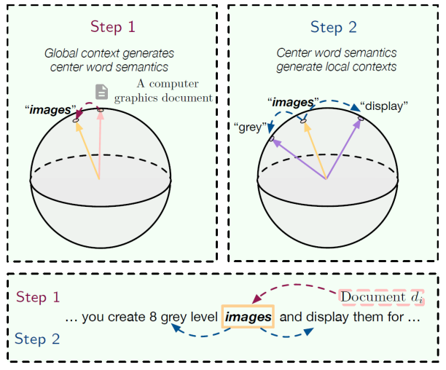
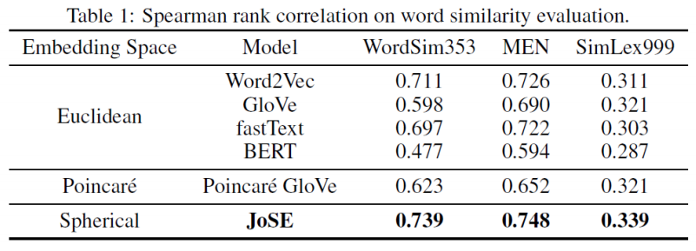
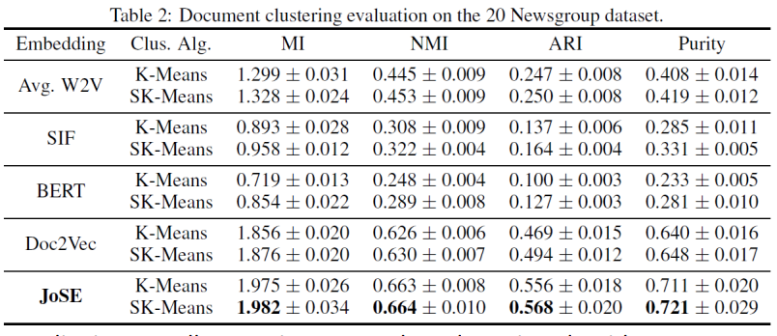
JoSE: Spherical Text Embedding
Spherical embeddings with better performance with a spherical clustering approach

Slide 11

METHODOLOGY
2. Identifying Critical Clusters
Second, the clusters with high tweet populations are identified, and labeld critical clusters
SK-means, the spherical clustering algorithm
Elbow curve method to determine the optimal value of k
Threshold-based approach (mean cluster population)
* Elbow curve method
1. Compute clustering algorithm (e.g., k-means clustering) for different values of k. For instance, by varying k from 1 to 10 clusters.
2. For each k, calculate the total within-cluster sum of square (wss).
3. Plot the curve of wss according to the number of clusters k.
4. The location of a bend (knee) in the plot is generally considered as an indicator of the appropriate number of clusters.

Slide 12
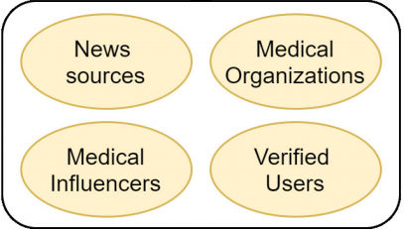
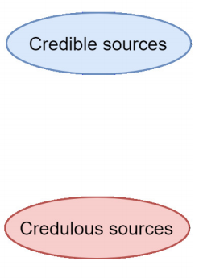
METHODOLOGY
3. Identifying the credible and credulous critical clusters
Backtrack the tweet-retweet connection -> identify the source
User_descritpions -> identify credulous users and contents
Divide critical clusters into two categories
Credible clusters: tweets from credible sources -> four primary categories
Credulous clusters: misinformed content not been verified

Slide 13
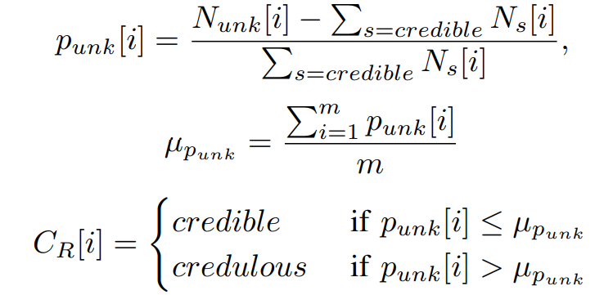

METHODOLOGY
3. Identifying the credible and credulous critical clusters
Keep the seed list of users by updating dynamically, using the user-description of verified users
Filter out the credible sourced clusters by backtracking all the tweets to their source users: N[i]
All the retweeted-users are labeled as one of the 4 categories or ‘Unknown user ’
Clusters categorization into credible and credulous clusters
Calculate the proportion of unknown users and mean of all clusters

Slide 14
METHODOLOGY
3. Emotion data labeling
Emotional coefficient per user categories : Sadness, fear, anger, and joy
Use the list of keywords curated by Saif M. Mohammad, which provide the label and score, that defines the intensity of that emotion for a given keyword when it is mentioned.
Average of the emotional score of all the keywords for each emotion
Tweet is labeled with the emotion of highest value

Slide 15
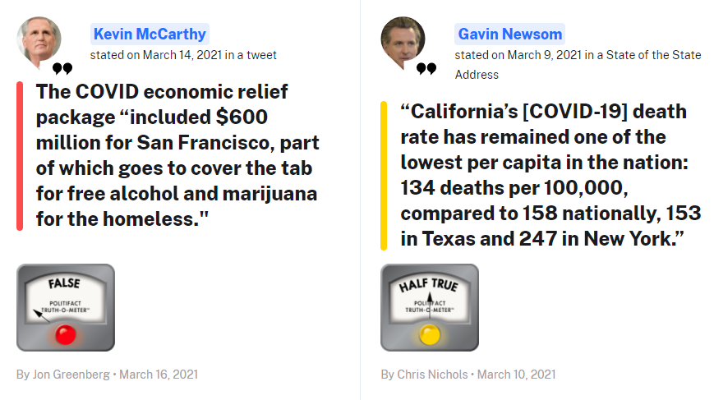
RESULTS AND DISCUSSION
Ground Truth Data
Validate model on two public fake new Twitter datasets
Annotations collected from Politifact and GossipCop website

Slide 16
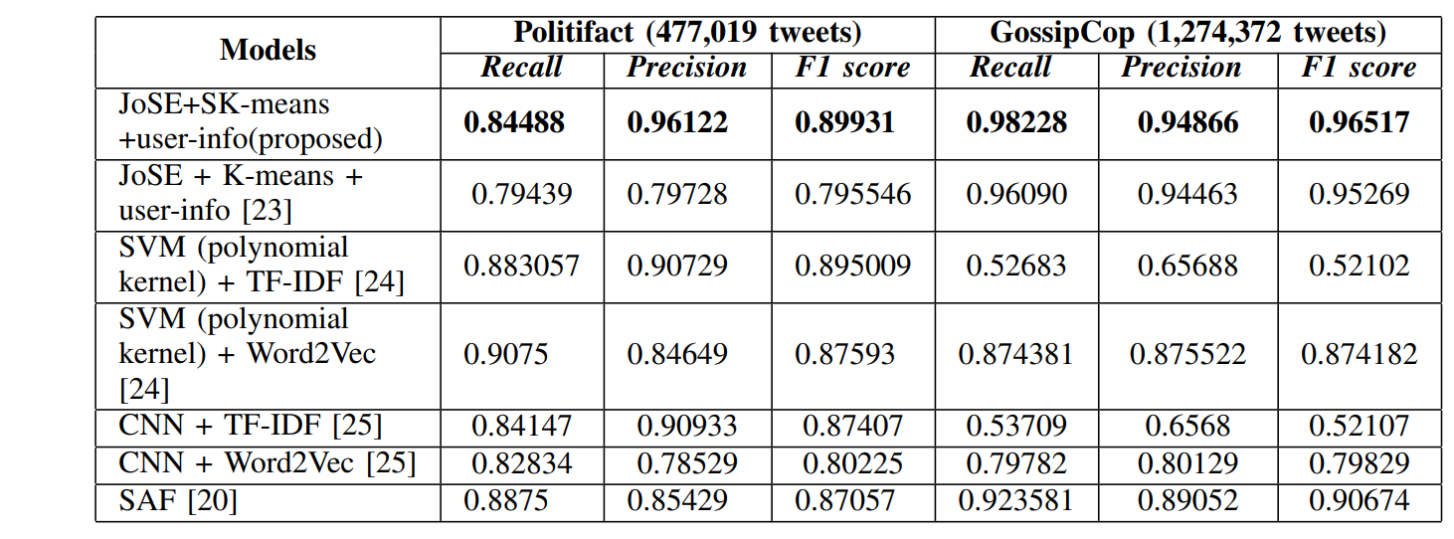
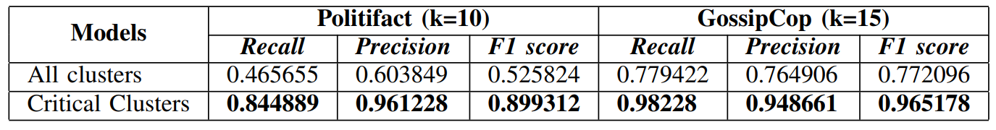
RESULTS AND DISCUSSION(추가필요)
Accuracy Performance Evaluation
Compared with baseline fake-news detection models
Generate the set of events from the credible news articles by using K-means clustering and then perform online clustering to filter out fake news from the existing credible clusters
K-means Clustering
Support Vector Machine
Convolutional Neural Network
Social Article Fusion

Slide 17
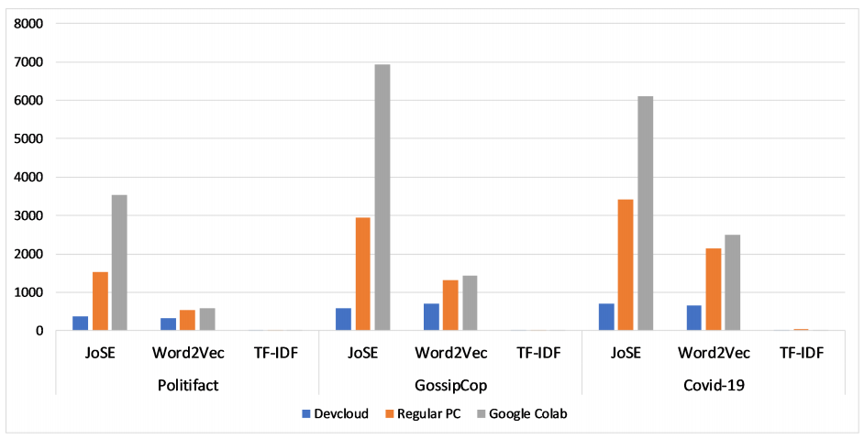
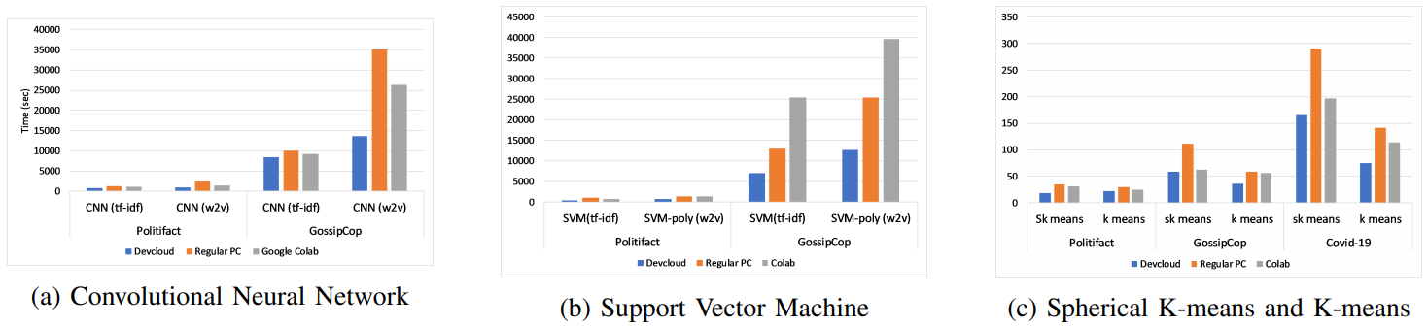
RESULTS AND DISCUSSION
Time Performance Evaluation
Embedding generation task (Politifact, GossipCop, COVID-19)
Clustering classification task
Embedding generation models
Extensive advantage of using DevCloud in terms of run-time for all tasks with variable sizes

Slide 18
RESULTS AND DISCUSSION
Validating the identified credulous COVID-19 tweet clusters and users
Credulous clusters were searched manually to validate the results of proposed model
Validation was also performed by checking the status of identified credulous users on Twitter

Slide 19
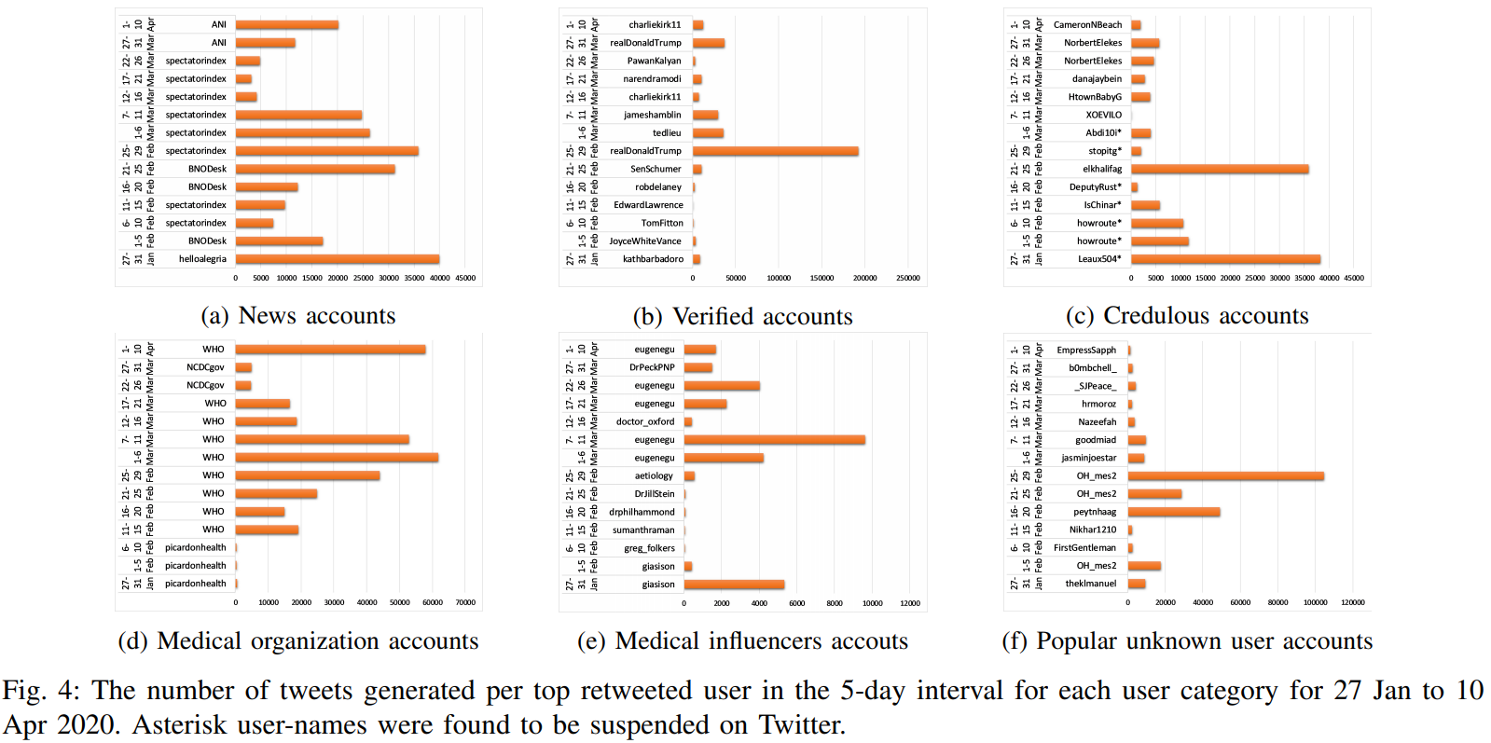
During mid-march, Twitter improved the security features
All the identified users belonged to the pre-mid-march duration

Slide 20
RESULTS AND DISCUSSION
Validating the identified credulous COVID-19 tweet clusters and users
Identify the geographical location of influenced users (user-locations mentioned in the user-profile)
Do not consider verified users’ followers and ordinary users

Slide 21
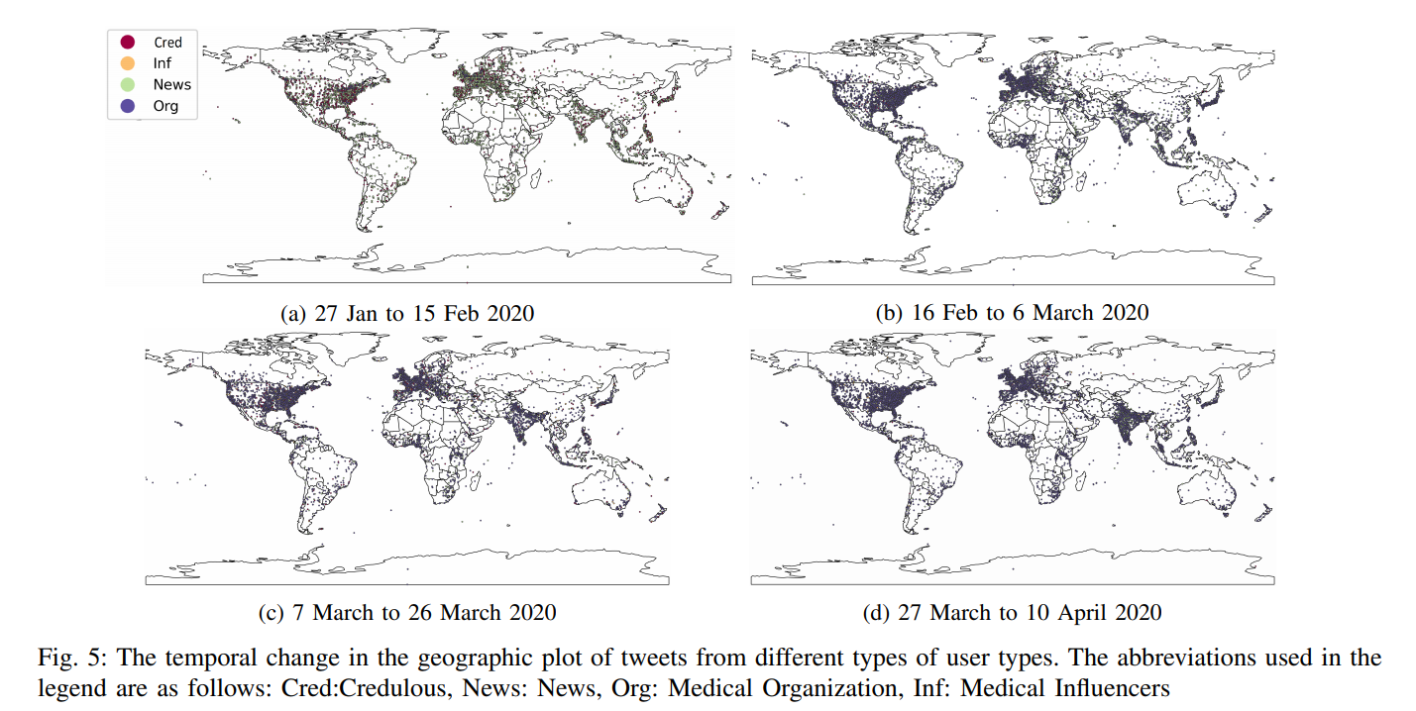
As the spread of the COVID-19 cases increases, the tweets and retweets also tend to increase

Slide 22
RESULTS AND DISCUSSION
Validating the credulous COVID-19 tweet clusters using Emotional Analysis
Emotion intensity scores and number of tweets per emotion for the different user-categories
Validates that the content of credulous clusters tend to show high proportion of anger and fear generating tweets with high intensities

Slide 23
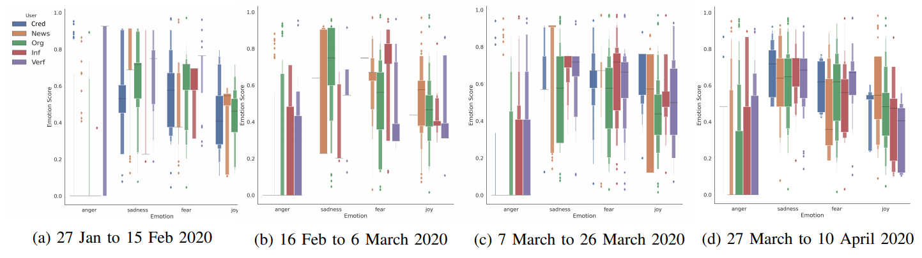
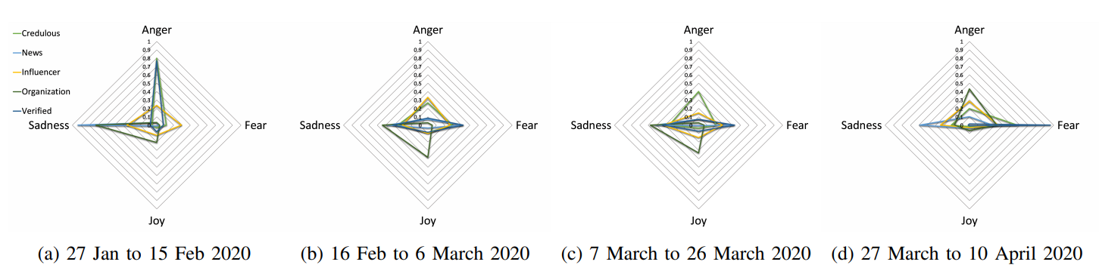
High intensity of sad and fearful tweets in credulous clusters
High proportion of angry, sad, and fearful tweets in credulous clusters

Slide 24
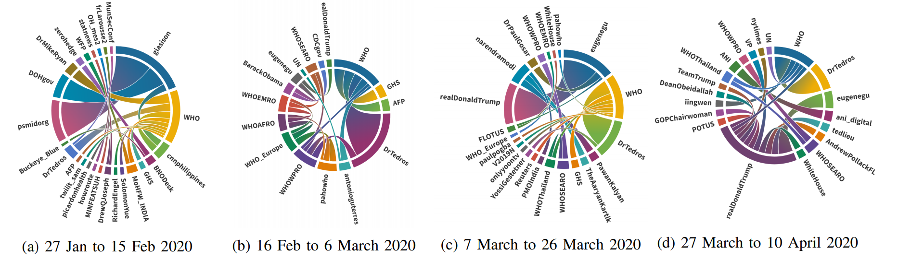
RESULTS AND DISCUSSION
Analyzing User-Interactions on COVID-19 dataset
Identify the most popular user-interactions in the whole data by using the poster of the tweet and the mentioned or retweeted users
Change in the pattern of user-interactions over the whole duration
Primary portion of major users are medical influencers, organizations, news, and verified accounts

Slide 25
CONCLUSION
Identify the misinformed content and the credulous users
Semantically similar cluster to extract the most influential content
Credible sources help in filtering out the credulous users and related information
Accuracy performance and Time performance increases upto 5% and 10% respectively
Higher affinity toward the angry, sad, and fearful tweets in the credulous clusters

Slide 26
FUTURE WORK
Performing a comparative analysis of credulous and credible sourced clusters in geographical spread of the type of user-interactions
Eliminating the possibility of sharing misinformation in credible sources

Slide 27
Thank you

